Slide 1

And Now Selenium’s Watch is Ended
Using Cypress to write UI tests that are less brittle and run faster
Matthew Knowles
Software Craftsman at Greater Sum
www.GreaterSum.com
@MatthewYKnowles
Matthew@GreaterSum.com

Slide 2
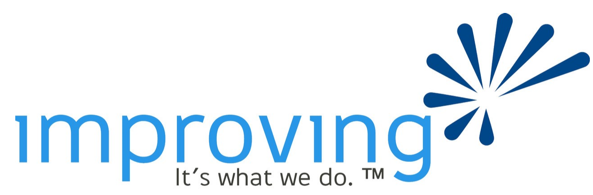
Platinum Sponsors

Slide 5

Roadmap
Tests
Testing with Selenium
Testing with Cypress
Live coding Cypress tests
Advanced UI testing techniques
Notes:
Goal of the talk is to breakdown any friction from preventing you from going out and writing some UI tests against your professional or personal project

Slide 6
Why do you write tests?
Notes:
Who here writes automated tests right now? (audience)
Why do you write tests? (audience)

Slide 7
Why Write Tests?
Verify functionality
Defend against unexpected change
Executable documentation of the code
Notes:
These are generally the answers I get

Slide 8
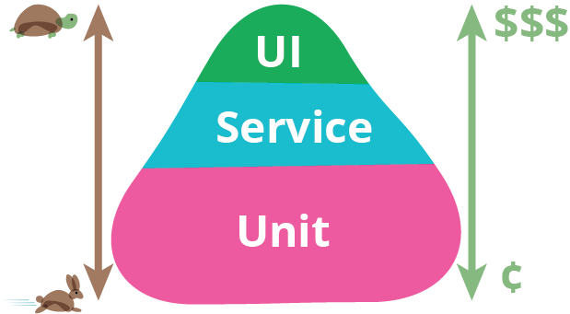
https://martinfowler.com/bliki/TestPyramid.html
Notes:
As companies are shortening the amount of time between production releases they starting to rely more and more on automated tests. Here you can see a visual representation of Martin Fowler’s Automated Testing Pyramid. This is supposed to serve as a guide to the proportions of different automated tests a team should have in their testing suite. Lots of unit tests to verify that each class or small chuck of code is doing what it is supposed to. Service level tests to make sure groups of classes are working together correctly. And finally UI tests to verify that all of the services are working together and are correctly configured. Unit tests are extremely fast and easy to write as represented by rabbit and cents logo.

Slide 9
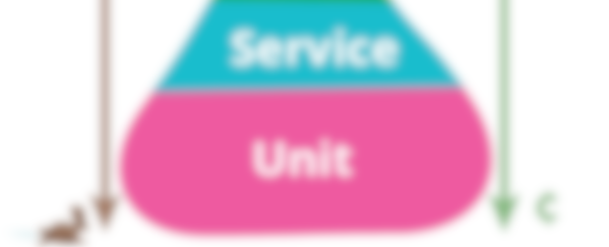
https://martinfowler.com/bliki/TestPyramid.html
Notes:
Today we are going to focus on the expensive turtle tests.

Slide 10
Why Write UI/E2E Tests
Verify that the critical path works
Exercise your code in a live or live like environment
Notes:
Did the code integrate properly? Are the environment variables set correctly? Am I connected to the correct database? Are permissions set correctly?

Slide 11
Why Write UI/E2E Tests
Human Readable
Behavior Driven Development (Dev/Product/Test)
Executable specification
Notes:
BDD has the goal of writing tests (usually UI tests) from the customers point of view that exemplifies a feature or capability of the program. These tests are meant to be simple enough in language that a representative from product, development, and QA can all understand what functionality is getting verified. If anyone has heard of Cucumber this is the goal that library is trying to achieve. If someone asks what the product I am working on does I immediately go to my UI test suite and start reading off the test names. I can login to the atlanta code camp website and favorite a talk. I can login as an admin and remove a speaker from the schedule if their flight to Atlanta was cancelled. As a participant I can get my 10 dollars refunded.

Slide 12
Why Write UI/E2E Tests
Legacy code
Notes:
If you’re code is currently untested UI tests can help verify if you broke any major functionality as you refactor your code to add tests to the backend or frontend. If you remember the automated testing pyramid from earlier I would highly recommend writing unit and service level tests and not just relying on UI tests.

Slide 13
Selenium to Cypress in a project
Notes:
Has anyone had the pleasure of writing Selenium tests? (audience)

Slide 14
Flaky tests

Slide 15
Debugging
Notes:
Finding out why a test failed is a lot easier (pictures, videos, DOM snapshot)

Slide 16
Failures in build pipeline
Notes:
Much easier to diagnose failures in CI

Slide 17
Test writing
Notes:
Writing new tests did not take as long

Slide 18
Time to execute
18 -> 10 minutes

Slide 19
Access outside browser
Notes:
Could no longer use port to verify information sent over email
File system issues

Slide 20
Intro to Cypress
Notes:
Testing framework for web applications
It is already in the browser. It knows whats going on in your application Can wait for async requests to resolve. As opposed to using a wait.

Slide 21
When not to use Cypress
Firefox, Safari, and Edge
Access outside the browser
Has been out of beta less than 1 year
Notes:
Selenium is more like a real user of the product.

Slide 22
Cypress Demo
Atlanta Code Camp 2019 Website

Slide 23
Cypress Demo
Connect Four

Slide 24
HTML Data Attribute

Slide 25
Cypress Demo
Connect Four with data attributes

Slide 26
Page Object Pattern

Slide 27
Cypress Demo
Connect Four with page objects

Slide 28
Image Comparison

Slide 29
Cypress Demo
Connect Four with image comparison

Slide 30
Whatever you would manually test try and automate
Notes:
Where you can start.
How will we know what we’ve made changes correctly?
How will we know that we haven’t broken anything?

Slide 31
https://martinfowler.com/bliki/TestPyramid.html
Notes:
We only had a chance to talk about the top

Slide 32
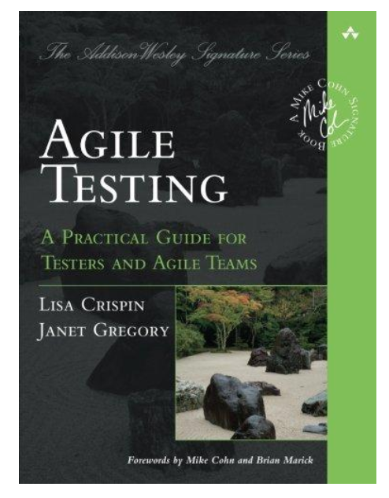
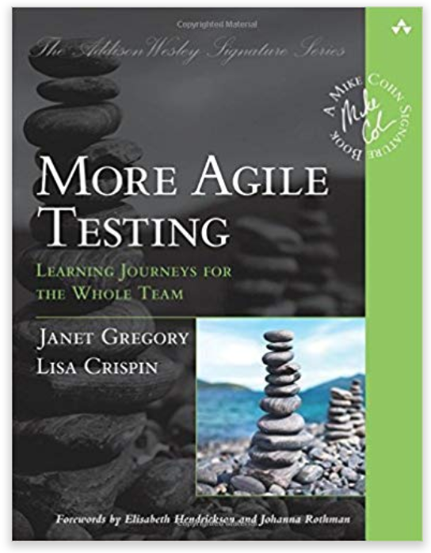
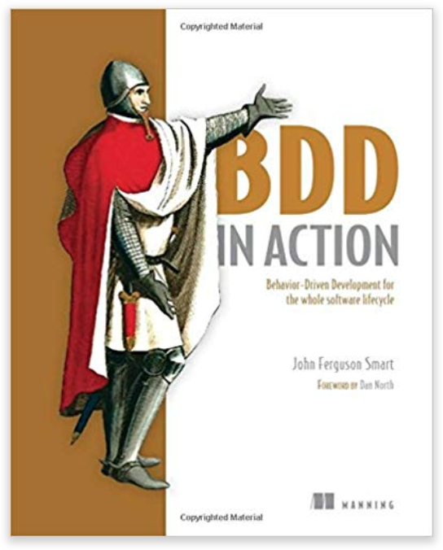
Resources
Notes:
We only had a chance to talk about the top

Slide 33
Questions?
@MatthewYKnowles
Matthew@GreaterSum.com

